Slide 1

Python analysis Project

Slide 2
Project Scenario
In this project, I worked with transactional data from an online retail store. I have explored and analyzed the dataset to gain insights into the store's sales trends, customer behavior, and popular products.
By conducting exploratory data analysis EDA, I have identified patterns, outliers, and correlations in the data, allowing me to make data-driven decisions and recommendations to optimize the store's operations and improve customer satisfaction.

Slide 3
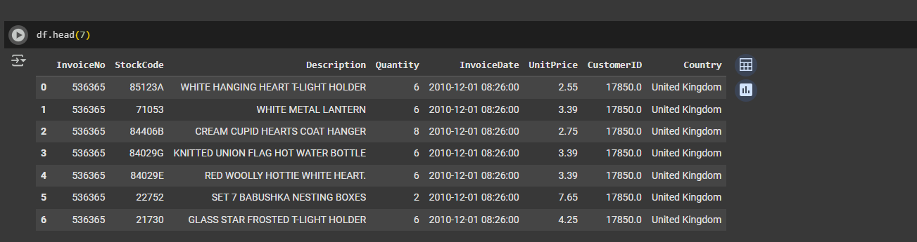
1. Load the dataset - display the first 7 rows

Slide 4
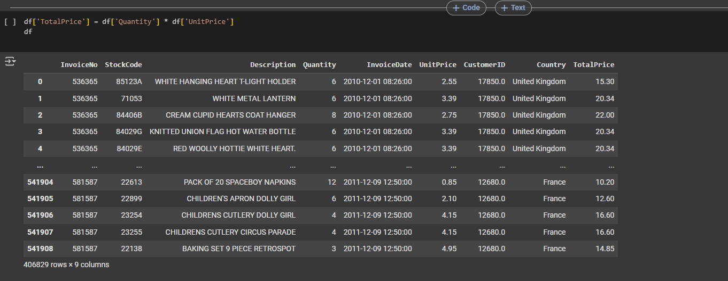
Adding total price column for each invoice

Slide 5
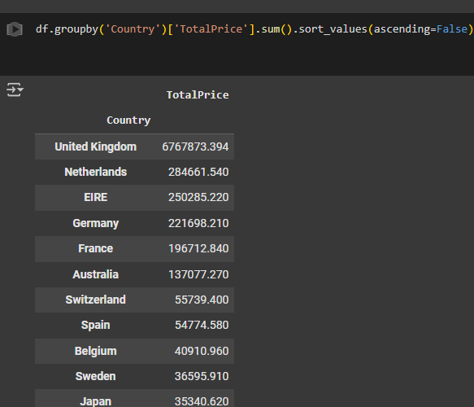
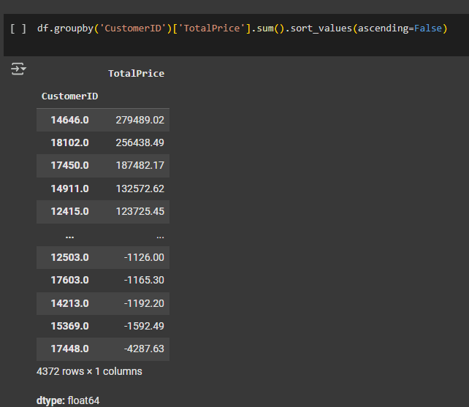
Customer Distribution & Country-wise Sales

Slide 6
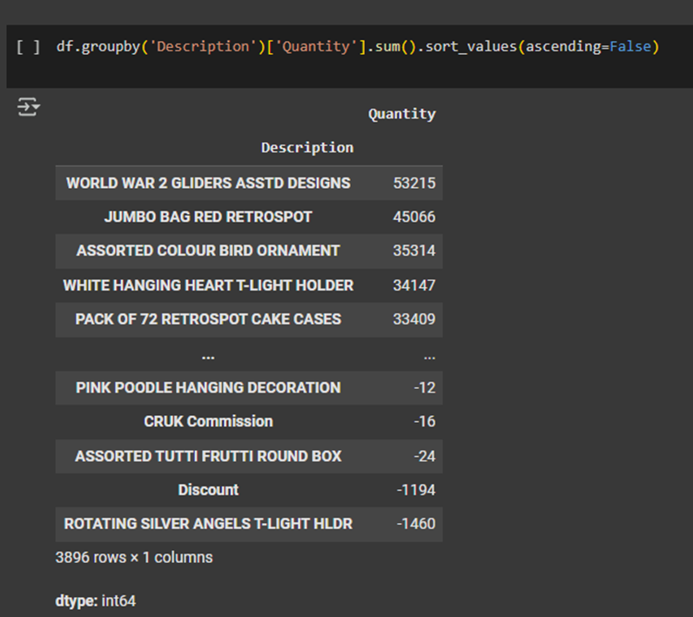
The sum of quantity sold for each product

Slide 7
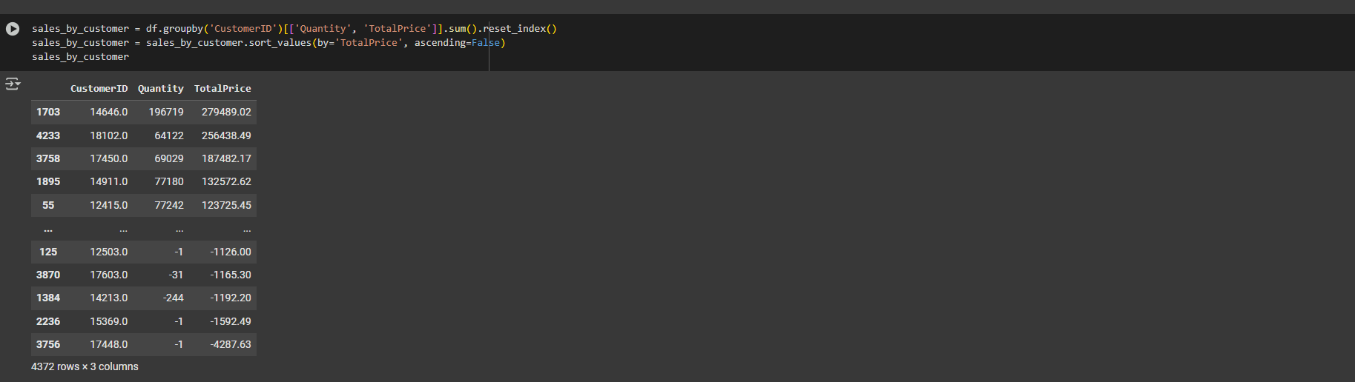
Creating a histogram to showcase the distribution of the number of purchases made by each customer

Slide 8
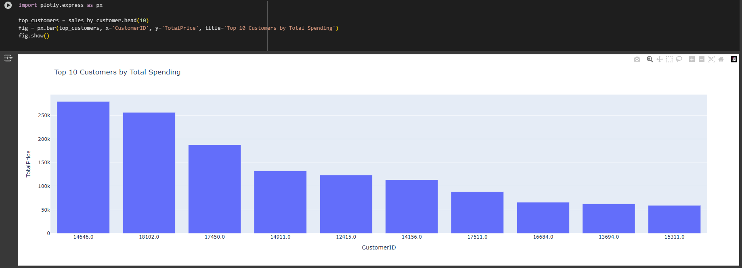
Top 10 Customers by Total Spending

Slide 9
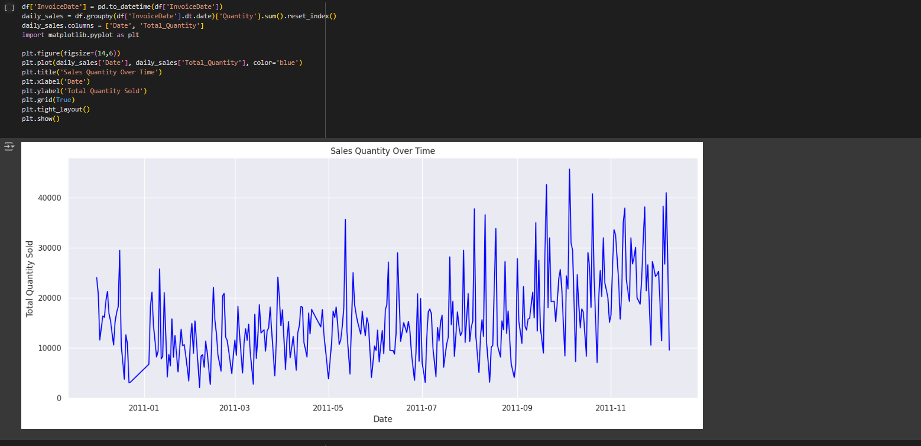
Sales Over Time

Slide 10
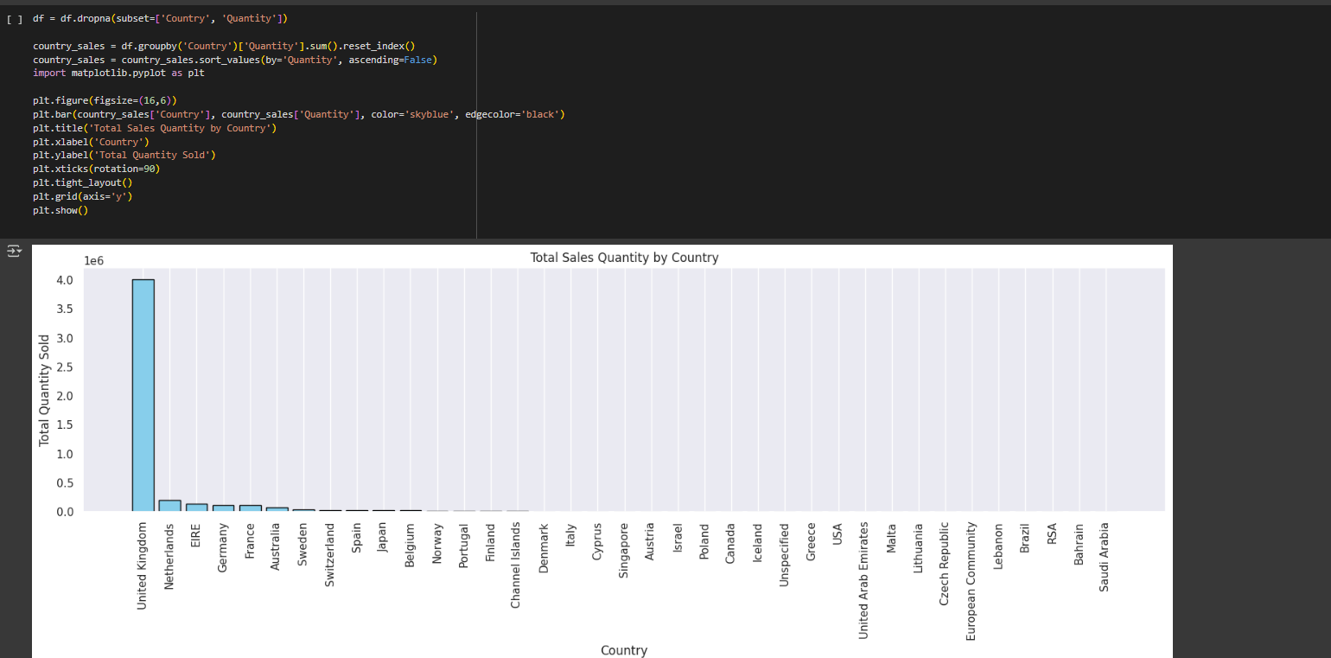
Creating a bar chart to visualize the total sales quantity for each country.

Slide 11
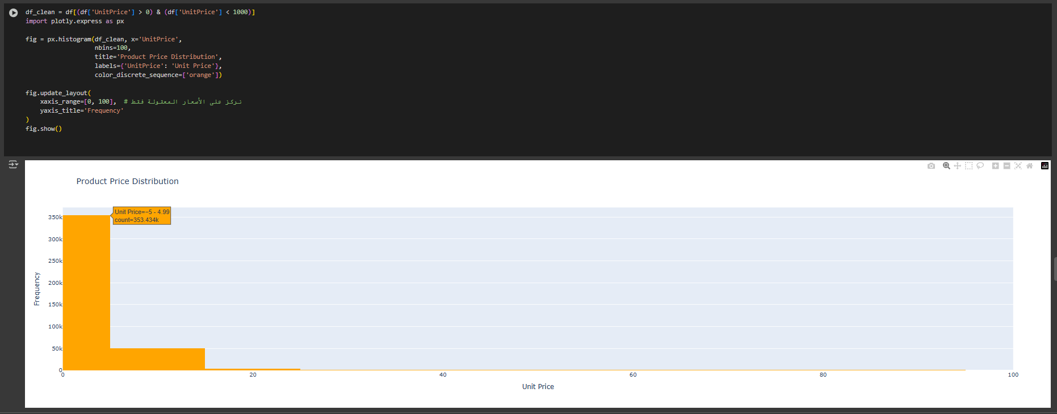
Product Price Distribution

Slide 12
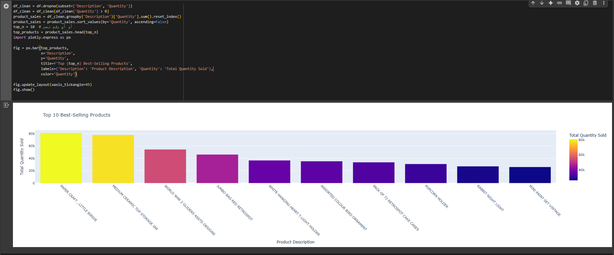
Top 10 Best-Selling Products

Slide 13
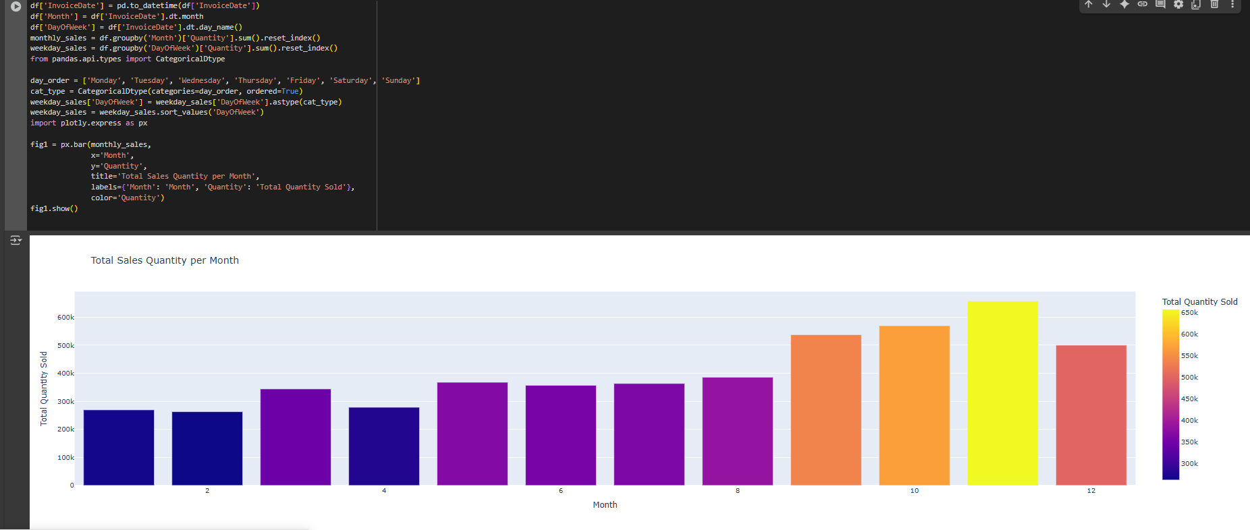
Total Sales Quantity per Month

Slide 14
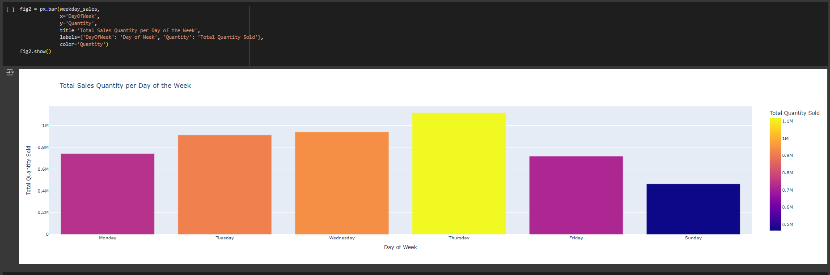
Total Sales Quantity per Day of the Week

Slide 15
Thanks

